Slide 1

Advance JavaScript
Object Oriented Programming
Lesson - 10

Slide 2
Objective
At the end of this lesson participants will be able to –
Implement Inheritance using JavaScript

Slide 3
Agenda
Prototypal inheritance
Prototypal inheritance using __proto__
Prototypal inheritance using create()
Prototypal inheritance using prototype

Slide 4
Prototypal inheritance
In JavaScript, the inheritance is prototype-based. Instead of class inherits from other class, an object inherits from another object.
object inherits from another object using the following syntax.
childObject.__proto__ = baseObject
Above mentioned syntax provided by Chrome / FireFox. In other browsers the property still exists internally, but it is hidden
childObject = Object.create(baseObject)
ConstructorFunction.prototype = baseObject
Above mentioned syntax works with all modern browsers.
Notes:
Add instructor notes here.

Slide 5
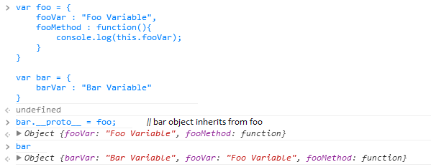
Prototypal inheritance using __proto__
Notes:
Add instructor notes here.

Slide 6
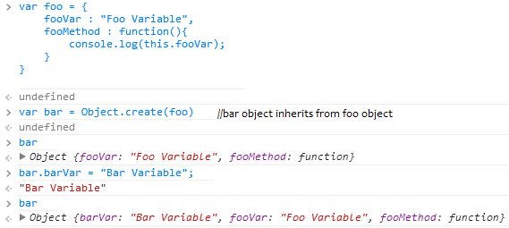
Prototypal inheritance using Object.create()
Notes:
Add instructor notes here.

Slide 7
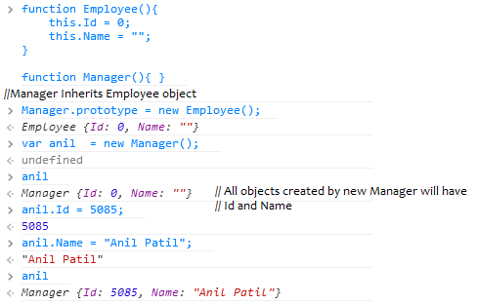
Prototypal inheritance using prototype
Notes:
Add instructor notes here.

Slide 8
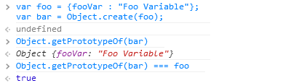
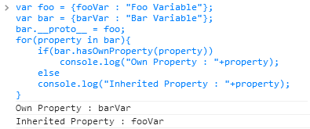
Prototypal inheritance
Object.getPrototypeOf(obj) returns the value of obj.__proto__.
for..in loop lists properties in the object and its prototype chain. obj.hasOwnProperty(prop) returns true if property belongs to that object.
Notes:
Add instructor notes here.

Slide 9
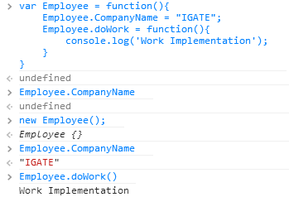
Static variables and methods
In JavaScript we can directly put data into function object which acts like Static member.
Static Members need to be accessed directly by Object name, cannot be accessed by reference variable. Static members gets created when the first object gets created.
Notes:
In JavaScript :
private variables are declared with the 'var' keyword inside the object, and can only be accessed by private functions and privileged methods.
private functions are declared inline inside the object's constructor (or alternatively may be defined via var functionName=function(){...}) and may only be called by privileged methods (including the object's constructor).
privileged methods are declared with this.methodName=function(){...} and may invoked by code external to the object.
public properties are declared with this.variableName and may be read/written from outside the object.
public methods are defined by Classname.prototype.methodName = function(){...} and may be called from outside the object.
prototype properties are defined by Classname.prototype.propertyName = someValue
static properties are defined by Classname.propertyName = someValue
Add instructor notes here.

Slide 10
Summary
In this lesson we have learned about -
Prototypal inheritance
Prototypal inheritance using __proto__
Prototypal inheritance using create()
Prototypal inheritance using prototype

